Slide 1

SIWES Technical Report
DevOps Engineering Industrial Attachment
Air Force Institute of Technology, Kaduna
Ambali Ridwan Oladele | U23/CS/1019 | September 2026

Slide 2
Table of contents
01
02
03
04
Introduction
DevOps
What SIWES is, and why it matters for computing students
What DevOps means, and the tools this attachment covered
Project
Skills
A live demo comparing a cached and uncached database fetch
Skills gained, and recommendations for future students

Slide 3
01
Introduction
What SIWES is, and why it matters

Slide 4
Introduction to SIWES
The Students Industrial Work Experience Scheme (SIWES) is a skills-training programme that exposes Nigerian tertiary students to real work environments before graduation, bridging the gap between classroom theory and industry practice.
This report documents an eight-week DevOps-focused attachment at KamSid BITS, covering the organization, the curriculum followed, weekly milestones, skills gained, and recommendations for future students.

Slide 5
02
DevOps Overview
What DevOps means, and the toolchain this attachment covered.

Slide 6


What is DevOps?
The Practice
Toolchain Covered
DevOps merges development and operations into one continuous cycle of automated builds and monitoring.
Linux, Git, Docker, Kubernetes, Jenkins, Terraform, Prometheus, and Grafana across the pipeline.

Slide 7
03
The Project
cache-demo: proving a warm cache beats a cold database, live.

Slide 8
cache-demo: No-Cache vs Cached
A cache sits in front of the database and remembers the answer to a question it has already been asked. The first request pays the full cost; every request after, until the cache expires, is nearly free.
The backend is a Go HTTP server with a hand-rolled Redis client and zero external dependencies, backed by Supabase Postgres for real data and deployed with a Vite frontend for the live comparison.

Slide 9
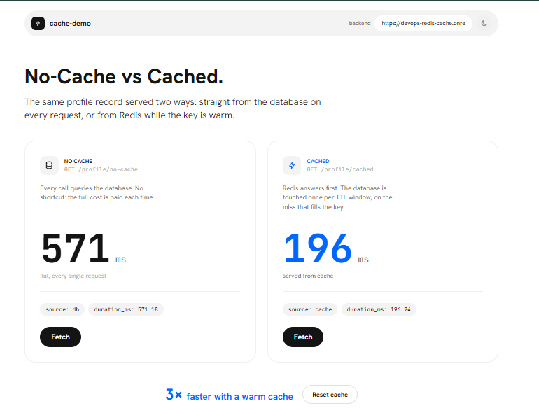
Live Demo: No-Cache vs Cached
What the Numbers Mean
The no-cache request reads straight from Supabase Postgres over the network: about 571ms. The cached request reads the same record from Redis in memory: about 196ms, roughly 3x faster. The saving grows with database latency and traffic.

Slide 10
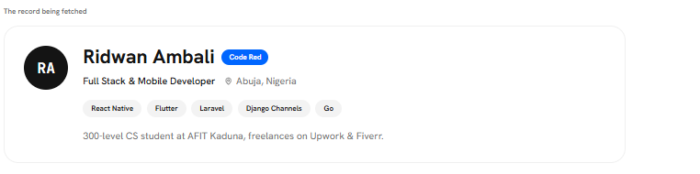
The Record Being Cached
Live, Not Hardcoded
This card is not placeholder data. It is fetched live from the backend on every page load, which reads from Supabase Postgres directly or from Redis when the cache is warm.

Slide 11
04
Skills & Recommendations
What I gained, and what I'd tell the next student

Slide 12


Skills Gained
Technical Skills
Professional Skills
Hands-on experience with Linux administration, containerization, orchestration, CI/CD pipelines, and infrastructure automation.
Improved problem-solving, technical documentation, teamwork, and communicating technical ideas clearly to others.

Slide 13
Recommendations
To the Organization | Provide clearer onboarding materials and a structured curriculum guide.
 | Encourage more hands-on group projects and peer collaboration.
To Future Students | Be proactive — ask questions and practice daily on your own machine.
 | Build a personal project portfolio alongside the attachment.
Looking Ahead | SIWES is a launchpad, not just an academic requirement.
 | Keep practicing cloud platforms and DevOps tooling to stay relevant.

Slide 14
Thank You
Ambali Ridwan Oladele
U23/CS/1019
Department of Computer Science, AFIT Kaduna
Supervised by: ChatWithBello
Please keep this slide for attribution

